Slide 1
GPT Understands, Too
Xiao Liu Yanan Zheng Zhengxiao Du Ming Ding Yujie Qian Zhilin Yang Jie Tang
From: Haoxuan Ma

Slide 2
Background
About prompt

Slide 3
Pre-trained language model (PLMs）
Background
Language Model：
LMs is used in natural language processing (NLP) to perform a variety of tasks.
-Text classification
-Machine translation
Three categories of PLMs:
-Unidirectional Language Model
-Bidirectional Language Model
-Hybrid Language Model
Notes:
Before the topic, let’s have a view of the background. GPT is a kind of language model, and language model is used in natural language processing to perform a variety of tasks like text classification , machine translation and so on.
According to the training objectives, pre-trained language models can be divided into three categories
Unidirectional Language Model
Bidirectional Language Model
And Hybrid Language Model

Slide 4
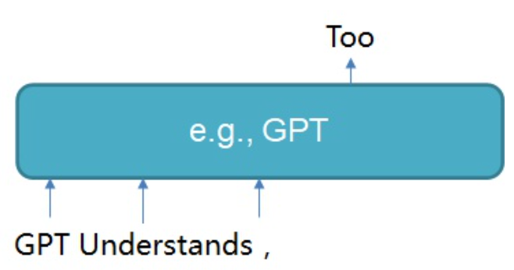
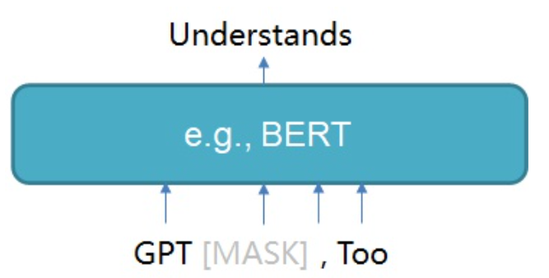
Pre-trained language model (PLMs）
Background
Unidirectional Language Model(GPT)
Bidirectional Language Model(BERT)
Notes:
And in the pre-trained language models,
The Unidirectional Language Model refers to the model that can only process input sequences in one direction, usually from left to right (or from right to left).
In this type of model, the model only considers the information before the current time step in the input sequence and uses it to predict the output at the current time step.
During training, the model only has access to past input, so it cannot use future context to predict the current output. Where GPT is a unidirectional language model
For example, in the left picture, when we want to predict what ‘s the next word after “GPT Understands,” We only use the token until this comma
And for the Bidirectional Language Model, a Bidirectional Language Model is a language model that is capable of processing input sequences in both directions
Unlike Unidirectional Language Models, Bidirectional Language Models are able to consider the entire input sequence when making predictions at each time step.
For example, in the right picture, when we want to predict the word between GPT and the comma, wo consider the whole sentence ai the time.

Slide 5
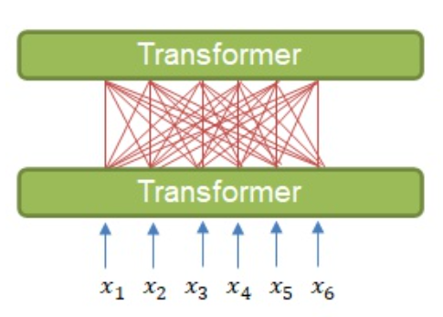
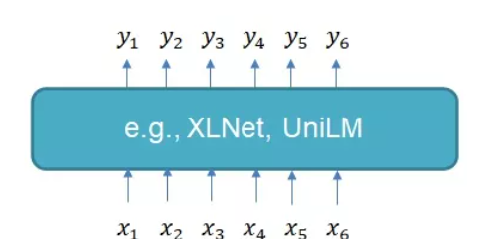
Pre-trained language model (PLMs）
Background
Hybrid Language Model(XLNet, UniLM)
Notes:
And different from the above two models, the hybrid language model combines the first two language model two。
Hybrid Language Models have been shown to be effective on a wide range of natural language processing tasks, such as language modeling, machine translation, and text classification.
However , our topic is about the GPT and BERT , so the Hybrid Language Model is not in out topic today.

Slide 6
Pre-trained language model (PLMs）
Background
Research Problem:
GPTs with traditional fine-tuning fail to achieve strong results on natural language understanding tasks.

Slide 7
GPT vs BERT
Background
Tasks in PLMs:
Natural language generation(NLG)
-Machine translation
-Autoreply for Email
Natural language understanding(NLU)
Knowledge Probing, Question Answering, Textual Entailment, Co-reference Resolution, Causal Reasoning, Word Sense-Disambiguation …

Slide 8
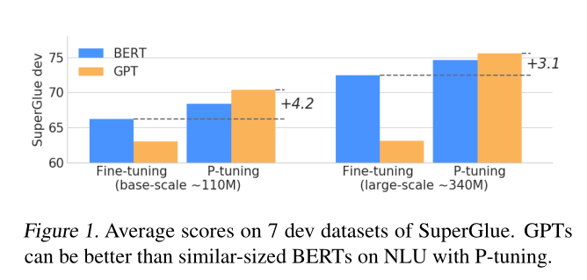
GPT vs BERT
Background
GPT(before GPT-3) performs poor in NLU tasks
Fine-tuning — using target training data to fine-tune model parameters.
P-tuning — in this paper

Slide 9
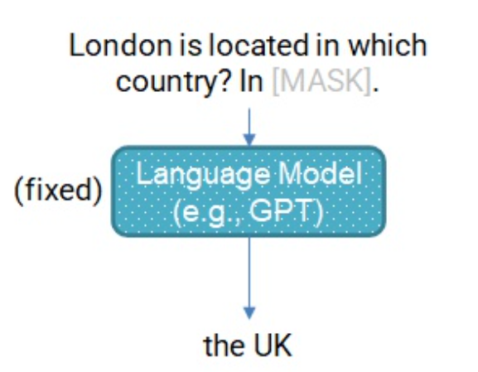
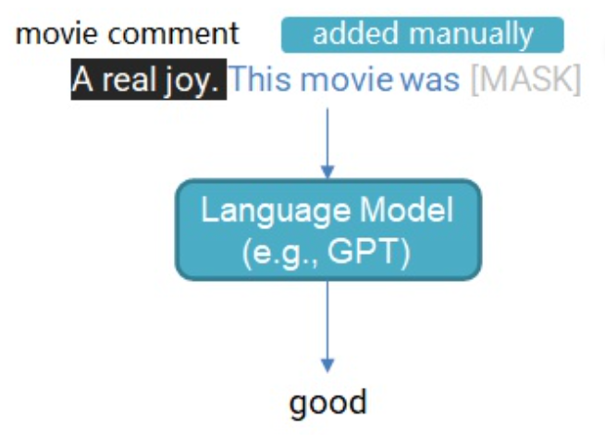
GPT-3—prompt
Background
GPT-3 : giant unidirectional language models together with appropriate
manual prompts may work for natural language understanding.
Prompt : NLU task —> blank-filling task
Prompt is the technique of making better use of the knowledge from the pre-trained model by adding additional texts to the input
Knowledge Probing :
Which country is London located in?
London is located in which country? In [MASK]
Text classification:
Movie comment:
Movie comment + This movie was [MASK]

Slide 10
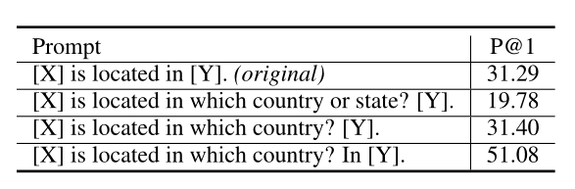
Prompt
Background
Main problem for manual prompt — volatile
How to solve this problem?
Y – [mask]
P@1-Precision@1：
represents the ability of the model to select the correct answer among the generated answers

Slide 11
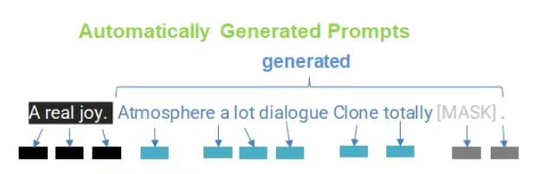
AutoPrompt
Background
Human decide
-Position of original input (movie comment – A real joy)
-Position of the blank [MASK]
Model fill
-Rest tokens of the prompt
”discrete prompts”

Slide 12
Method
P-tuning

Slide 13
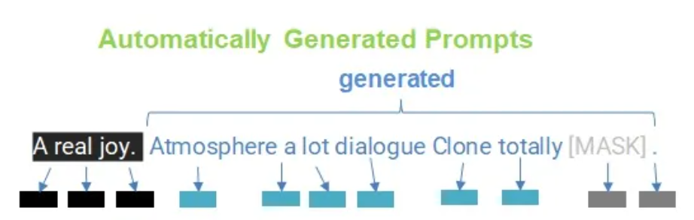
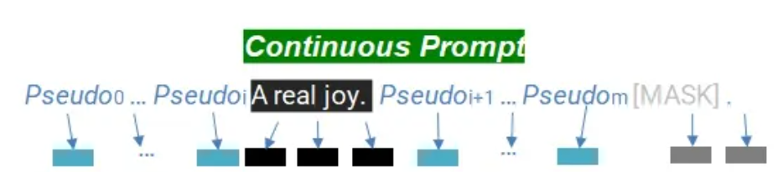
AutoPrompt in continuous space
Method
Why continuous?
- discrete prompt : select the most appropriate tokens from a vocabulary
- continuous prompt: add Pseudo prompt tokens and learn vector representations

Slide 14
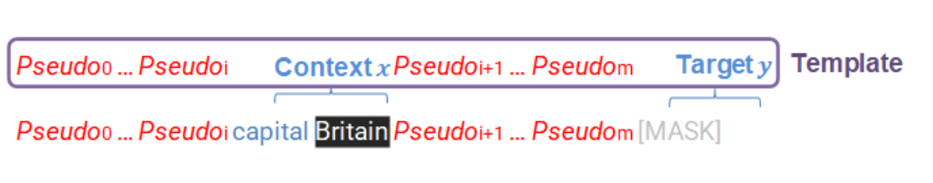
Architecture
Method
Template T:
-Context x : depends on the task or your design
-Target Y : the answer
-Prompt : Pseudo tokens
Task : what is the capital of Britain?
Notes:
Supposed that we have a template T, it’s constructed by the context x, target y , and the prompt.
the context x is the original input of your task. What is exactly the depends on your task or your design. For example, if your task is text classification, then context is the sentence you want to classify. If your task is that you want to get an answer to the question of what is the capital of Britain by asking the model, then your input can be capital Britain. All in all, the design of context is flexible. It is not necessary to be the same as demonstrated here.
The target y is the answer. Its position indicates where you want the model to put its prediction.
Then, you can create a prompt template:
In this template, you add some pseudo prompt tokens (e.g., the tokens) around your context. Note that, how many prompt tokens to add and how to decide the positions of these tokens are very flexible. You can design any template in any format that you want.

Slide 15


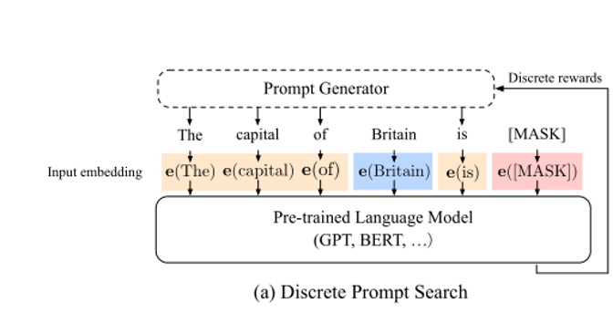

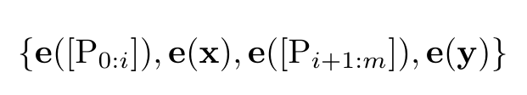
Architecture
Method
pre-trained embedding layers
Template :
Notes:
and for example here is an example for the discrete prompt template
x 1 to n refers to the input discrete tokens
and the Pi refers to the number i prompt token in the template
so the discrete prompt template T is constructed as P zero to i, x, p i plus one to m and y
however, to fit the different language tasks, we put them in to the pre-trained embedding layes
and the template is totally transfer to the e P zero to i e x e p i plus one to m and e y

Slide 16
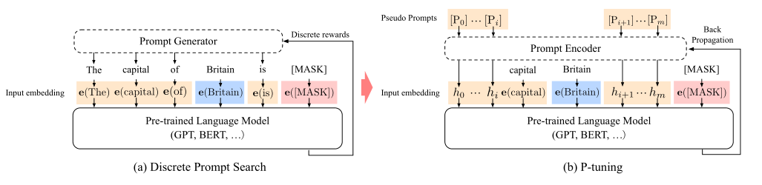
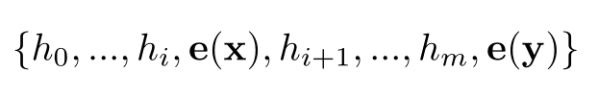
P-tuning
Method
Template :
Notes:
and for the p-tuing method in this paper discards the formal discrete prompt tokens
and instead regards the Pi as pseudo tokens and map the new template
into h zero to i e x, h i plus one to m and ey

Slide 17
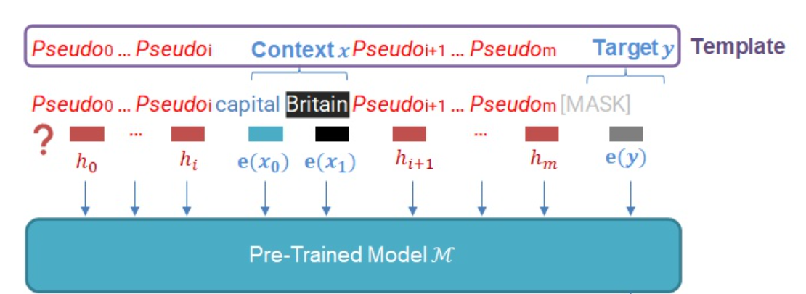
P-tuning
Method
How to obtain the vectors of the pseudo prompt tokens
Notes:
Now, we have got the template for the task what is the capital of Britain. We need to figure out how to use vectors to represent the template as the model input.
It is easy to get the vector representations of the context and target by directly obtaining the vectors from the embedding layer of the pre-trained model.
however, it’s difficult to obtain the vectors of the pseudo prompt tokens.

Slide 18
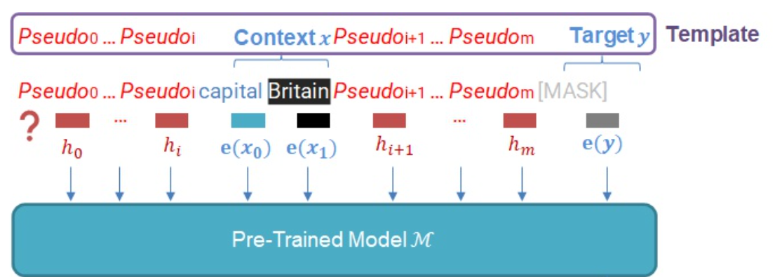
Optimization
Method
How we obtain the vectors of the pseudo prompt tokens ?
-Discreteness : optimizer would easily fall into local minima.
-Association : hi should be dependent on each other rather than independent
Notes:
and to obtain the vectors of the Pseudo prompt tokens, we need to consider two major factsors
the first is discretness the original word embedding e of M has already become highly discrete after pre-training. If h is
initialized with random distribution and then optimized with (SGD), which has been proved to
only change the parameters in a small neighborhood the optimizer would easily fall into local minima.
and the second factor is that believe the values of prompt embeddings hi should be dependent on each other rather than independent.
We need some mechanism to associate prompt embeddings with each other.

Slide 19
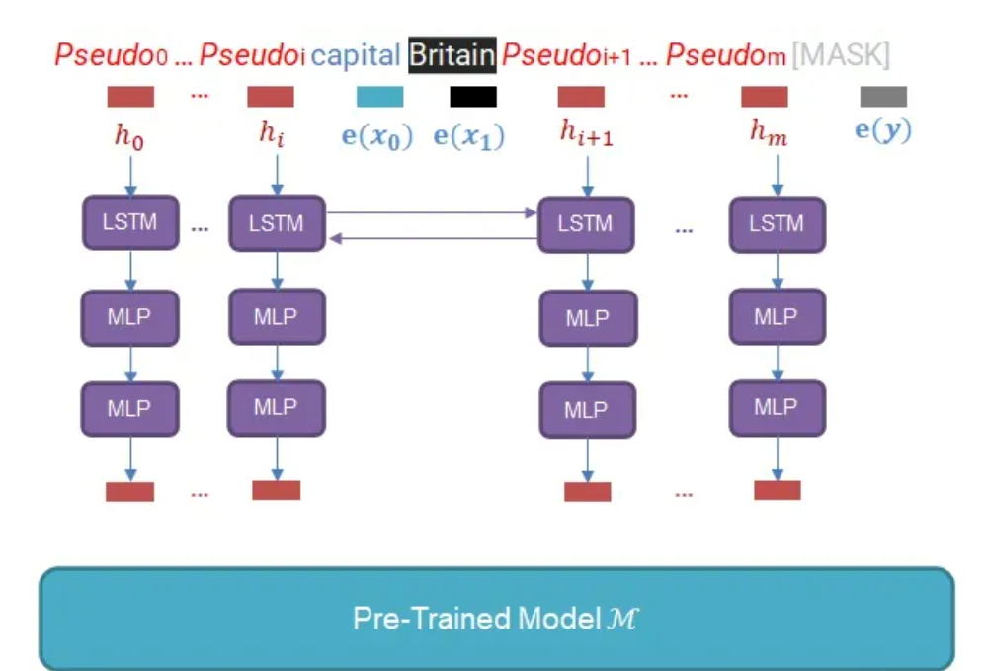
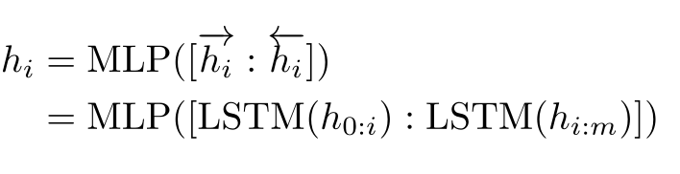
Optimization
Method
Bidirectional long-short term memory networks (LSTM)
ReLU activated two-layer multilayer perceptron (MLP)
Notes:
in the P-tuning we propose to also model the hi as a sequence using a prompt encoder consists of a very lite neural network that can solve the discreteness and association problems. And in practice, we choose a bidirectional long-short term memory networks (LSTM), with a ReLU activated two-layer multilayer perceptron (MLP) to encourage discreteness. Formally speaking, the real input
embeddings h0i to the language model M is derived from
hi equals the MLP of (LSTM h zero to i and LSTM h i to m

Slide 20
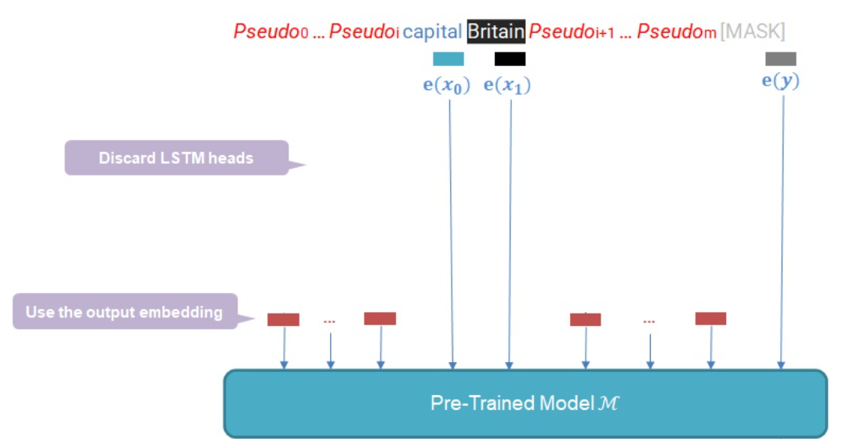
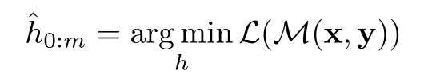
Optimization
Method
Final model:
-Discard LSTM:
LSTM head is several magnitude orders smaller than the pre-trained model.

Slide 21
Experiment
LAMA
SuperGLUE

Slide 22
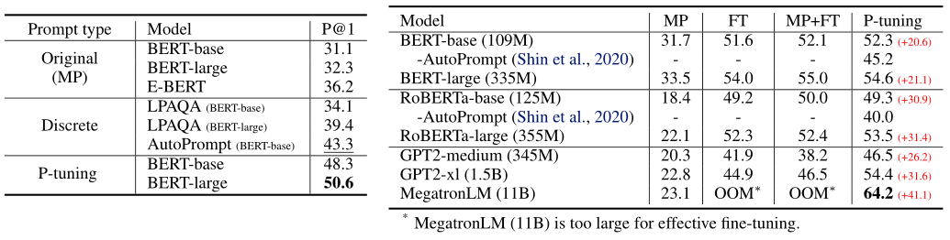
LAMA（Language Model Analysis）
Experiment
LAMA knowledge probing – model be fixed

Slide 23
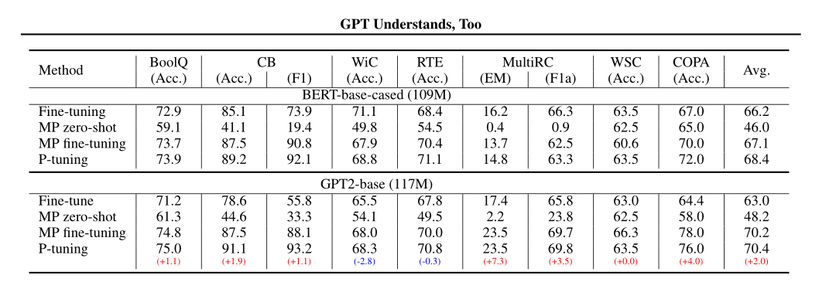
SuperGLUE(General Language Understanding Evaluation)
Experiment

Slide 24
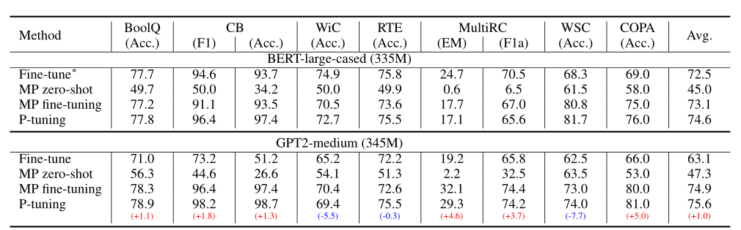
SuperGLUE(General Language Understanding Evaluation)
Experiment

Slide 25
Conclusion

Slide 26
Conclusion
Conclusion
This paper present P-tuning which can automatically search prompts in the continuous space
P-tuning augments pre-trained models' (e.g., GPT, BERT) ability in Natural Language Understanding tasks
The results of Knowledge Probing also prove that the language model captures more world knowledge than we thought

